Slide 1


CANoe DMM implementation
More Lives Saved
More Life Lived
Victor Ursache
SWV

Slide 2
1. Needed files:
1.1 DMMargs.pyw && USBMultimeter.py → Functions for USB communication with DMM
1.2 DMMControl.cin → Functions for CAPL scripts
1.3 DMM.vsysvar → System variables
1.4 DigitalMultimeterPanelControl.can && DMMNode.can → Panel control functions / event (button) handlers
1.5 DigitalMultimeterPanel.xvp → Panel interface
1.6 sMeasureFile.txt → DMMoutput file
PTC location: e:/MKSProjects/SWVR_PP_CI_Activities/CANOE_TEST_PLATFORM/Includes/HW_Modules/DMM/
Implemented and tested on : CANoe Build 15.4.35 (SP4) – 64 bit

Slide 3
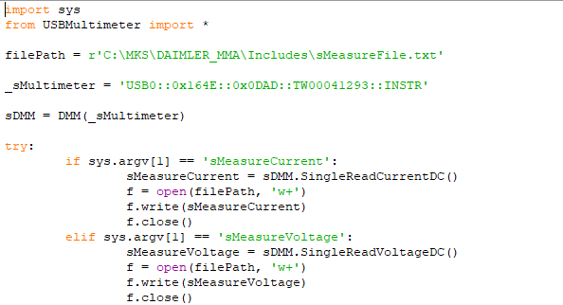
1.1 DMMargs.pyw && USBMultimeter.py
DMMargs.pyw: filePath and _sMultimeter should be updated if they were changed;
USBMultimeter.py: should be added in the same file as DMMargs.pyw;
1

Slide 4
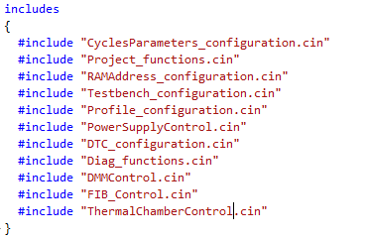
1.2 DMMControl.cin
If you wish to access DMM functionality through CAPL scripts, this must be included, otherwise skip this step.
E.g., for DAIMLER MMA:

Slide 5
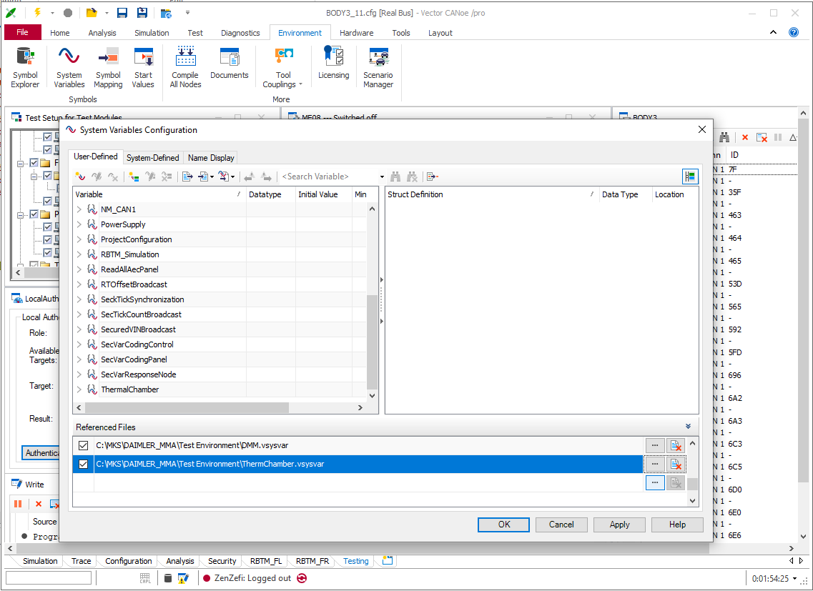
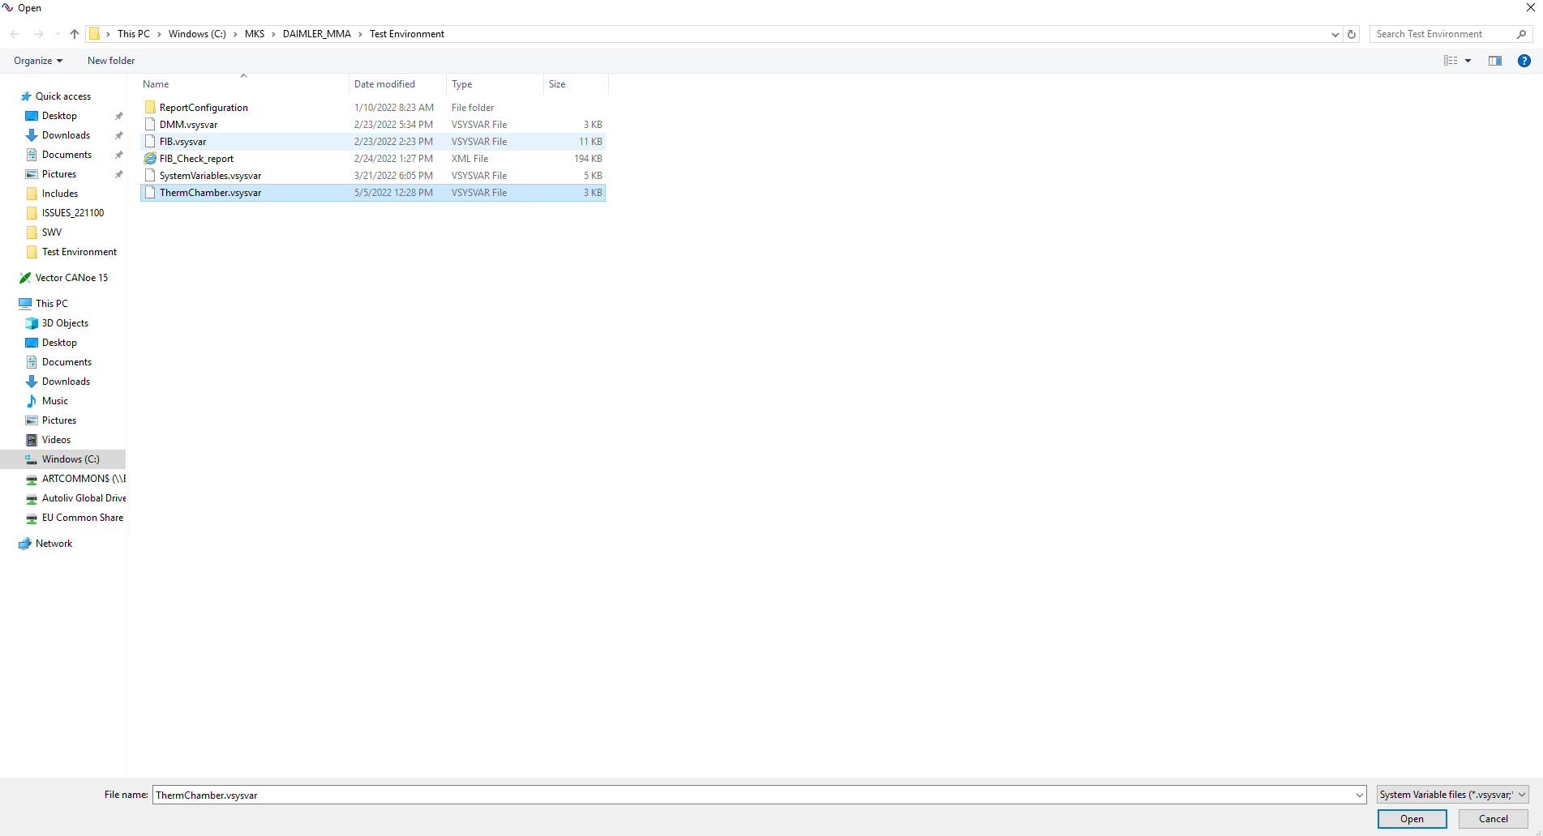
1.3 DMM.vsysvar
Import to CANoe configuration: Environment → System Variables → Select File → Open → Apply → OK
Also, be sure that checkbox from is checked.
1
2
4
5
*
3
7
6
*

Slide 6
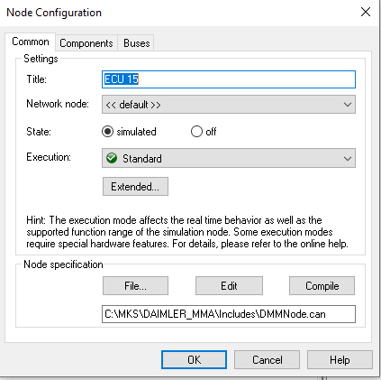
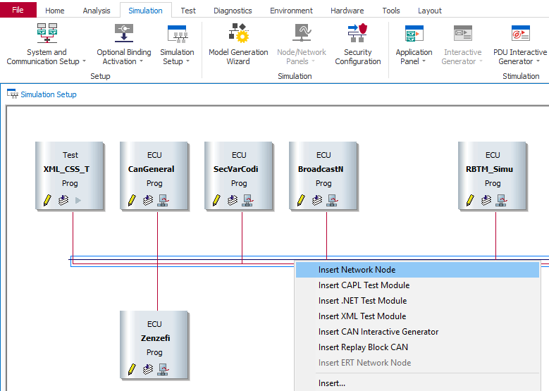
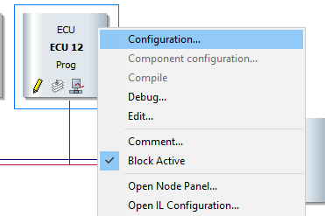
1.4 DMMNode.can
Add to CANoe:
Simulation → Simulation Setup → Right click on BUS → Insert Network Node
Right click the new generated node → Configuration → File → Open DMMNode.can
1
2
4
3
5

Slide 7
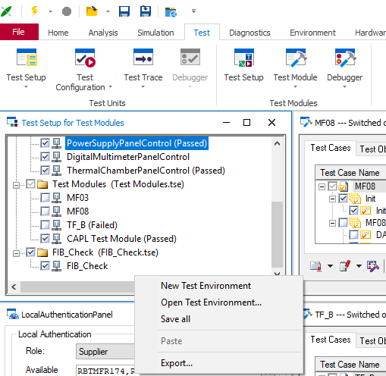
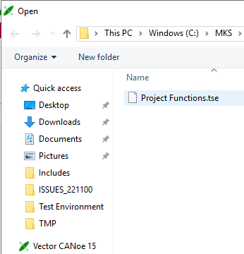
1.4 DigitalMultimeterPanelControl.can
Add to CANoe:
Test→ Test Setup → Right click on the bottom of Test Setup for Test Modules → Open Test Environment → Project Functions.tse (pay attention: this *.tse file will add also other features like TMP or PowerSupply);
1
2
4
3

Slide 8
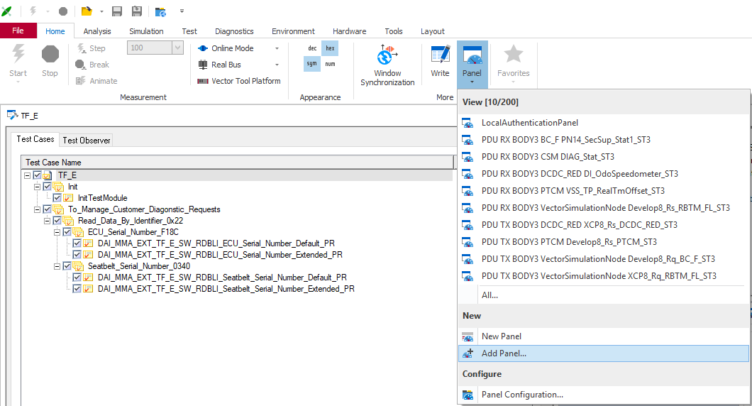
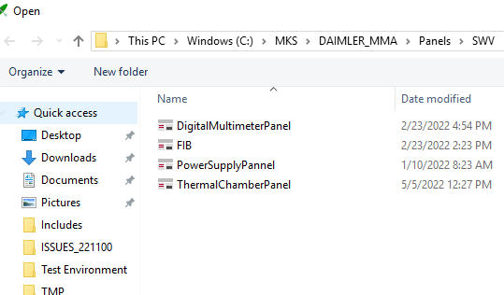
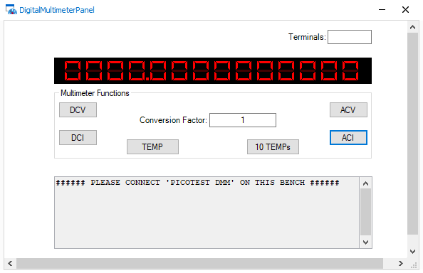
1.5 DigitalMultimeterPanel.xvp
Import to CANoe configuration: Home → Panel → Add Panel… → DigitalMultimeterPanel.xvp
After : 1. Terminals: reads the actual settings: FRONT or REAR (if error shows ERROR);
2. DCV button: reads the actual DC voltage;
3. DCI button: reads the actual DC current;
4. ACV button: reads the actual AC voltage;
5. ACI button: reads the actual AC current;
6. TEMP button: reads the actual 1xTemperature;
7. 10 TEMPs button: reads the actual 10xTemp (only one DMM has this HW extension);
8. Conversion Factor input: used to read current/voltage in the wright measure unit;
9. All info will be shown on ‘DMM Output’.
1
2
4
3
4

Slide 9

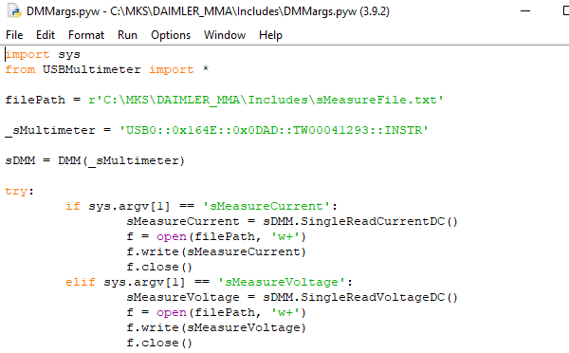
1.6 sMeasureFile.txt
sMeasureFile.txt is the DMM output file. This file can be created manually or *.py file will create this file automatically (modify the filePath as you need and _sMultimeter);
1
2

Slide 10

Saving More Lives

